Slide 1
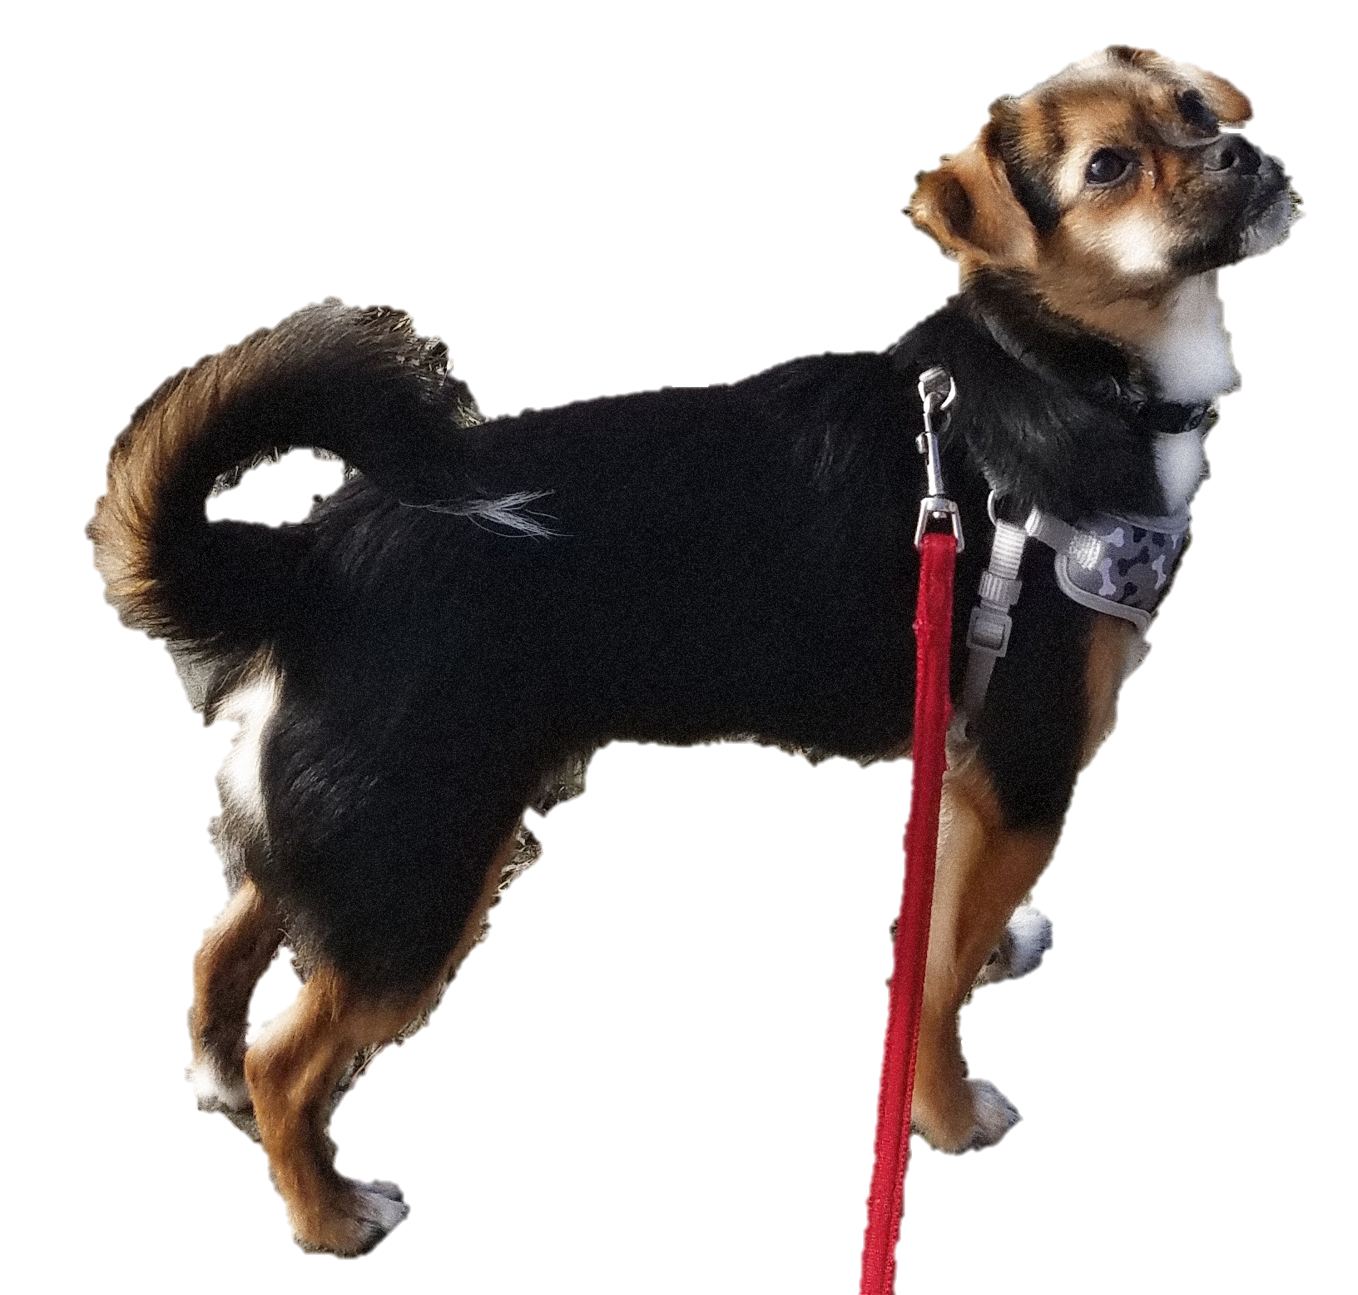

Learn with Chewie
High Five
Prerequisite: Before you teach your dog to high five, make sure your dog can sit and give a low five.
Teaching high five is similar to the low five, but turning your hand over so your fingers are on top.
Note: Do not use verbal commands when you begin to teach a new trick. Add the verbal command in after the behavior has successfully been completed and rewarded consistently.
Reach out for your dog’s paw to signal low five.
Give a treat right away when behavior has been completed.
Raise your hand a little higher than you normally would to start to introduce the high five.
Do not treat your dog if he reaches out to give you his paw and misses, as that will confuse him.
Raise your hand up higher until you can turn your hand over and get him to high five.
Repeat the high five and treating with success.
Introduce the verbal command when your dog has repeated a successful high five multiple times.
Always end your training session on a positive note and give your dog praise for their success.

Slide 2
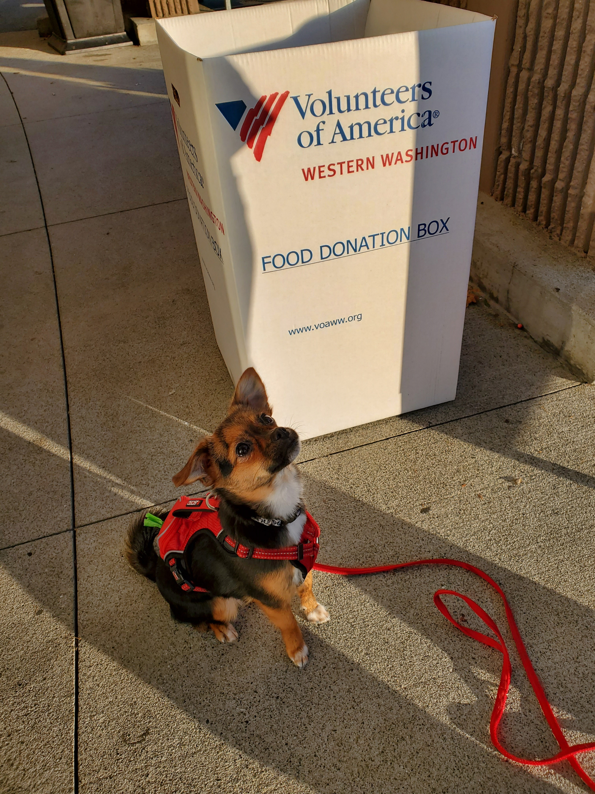

Slide 3
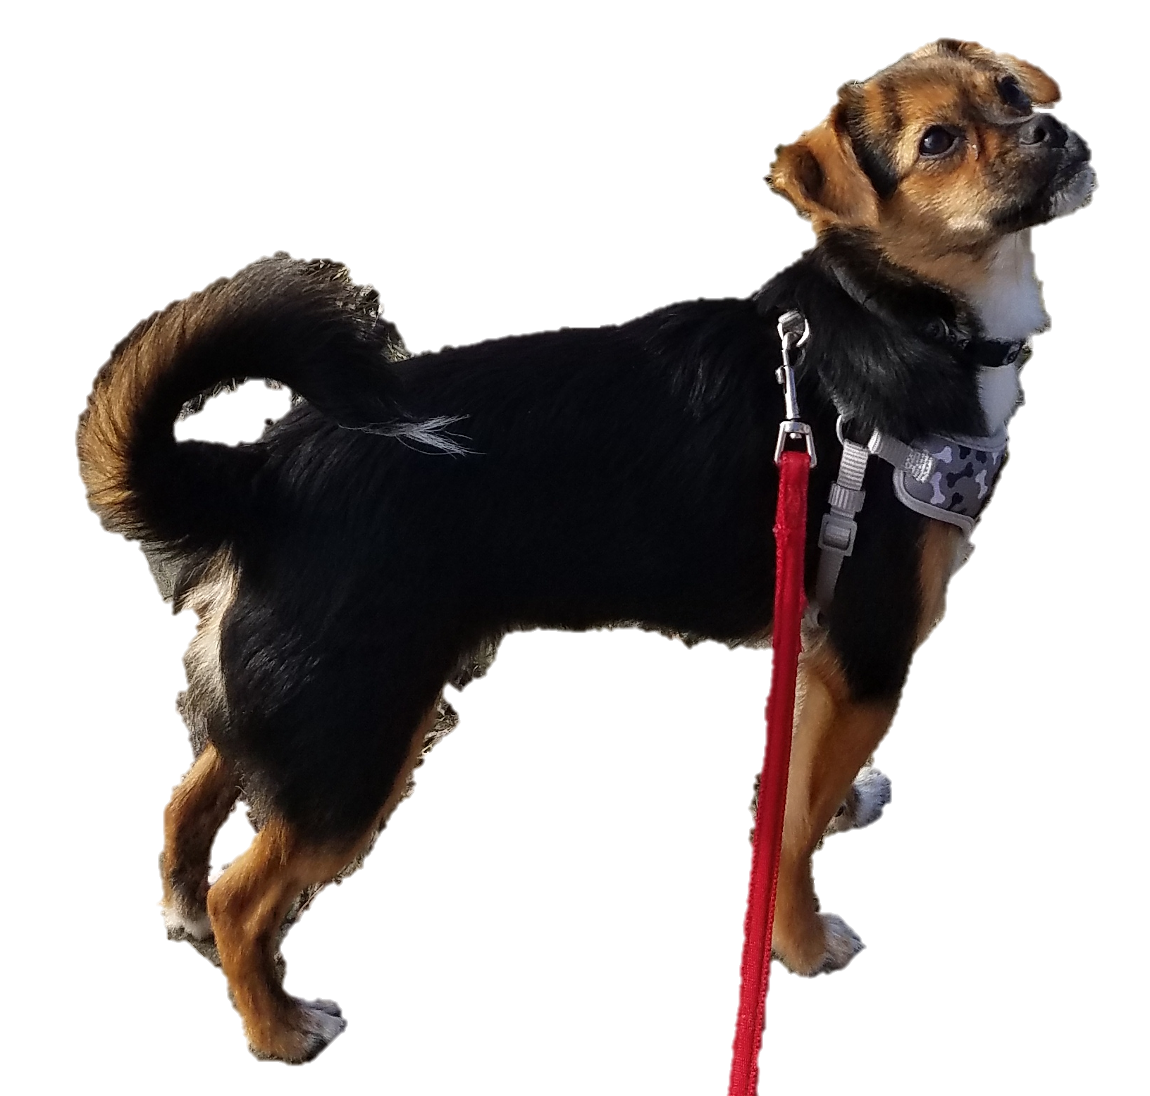

Slide 5
